Slide 1
Software Reliability and Quality Control
Gu Qing
Nanjing University
2020年3月30日

Slide 2
Chapter 2. Software Reliability Models
Randomness and Probability
Basic Reliability Models
Reliability Growth Models

Slide 3
3. Reliability Growth Models
Reliability Growth Models
Basic Exponential model (BE)
Logarithmic Poisson model (LP)
Apply the model
Time to reach target failure intensity (FIO)
Means execution time or experienced failure numbers
Notes:
λ(t)的变化函数

Slide 4
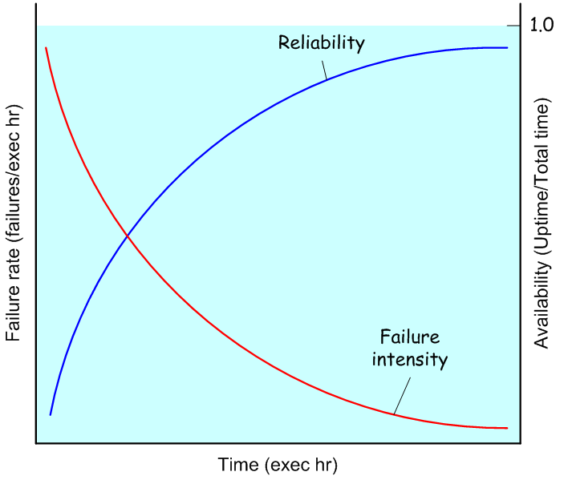
Reliability Growth
During software development, faults will be fixed, leading to a lower probability of failure
Reliability growth: longer time to failure Δt_{i} = t_{i}–t_{i–1} after a repair, or failure rate decreased over time

Slide 5
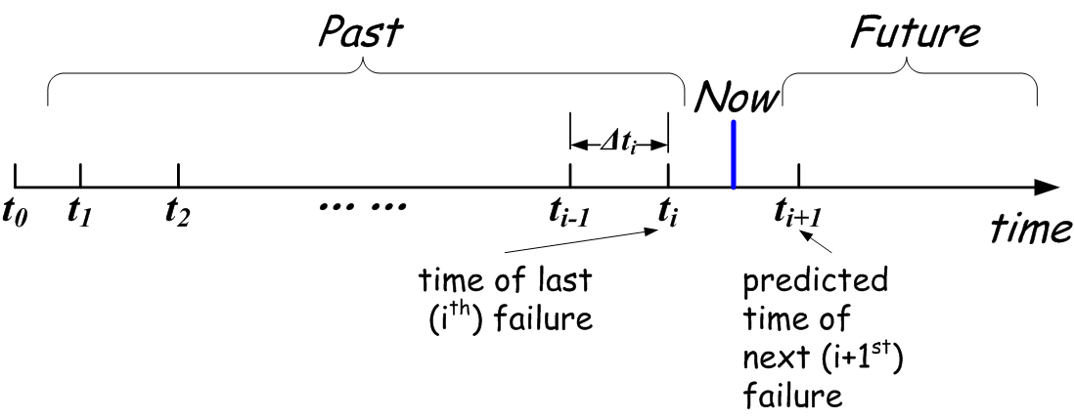
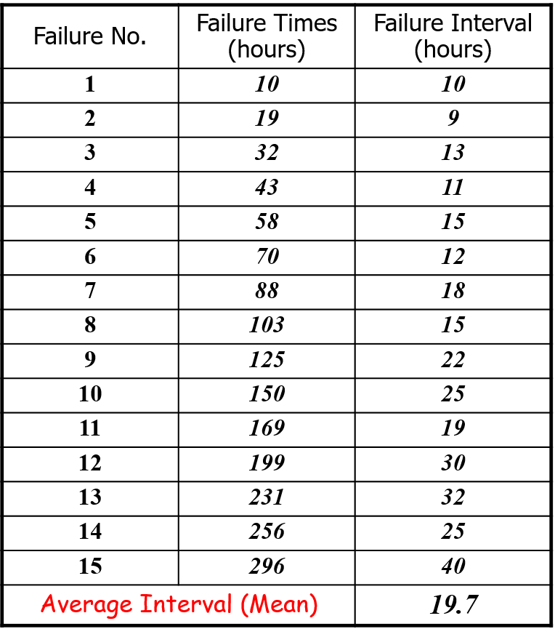
Illustration of Reliability Growth
Expected time to next failure is longer, or
Expected number of failures during certain time period (failure intensity) is fewer
Notes:
MTTF = 1/λ

Slide 6
Model Classification
Time domain
Calendar or execution time
Category
Number of failures is finite or infinite
Type
Distributions of the number of failures experienced by the time specified
Presentation
Functional form of the failure intensity over time
Functional form of the failure intensity in terms of the expected number of failures experienced

Slide 7
Various Reliability Models (1)
Exponential Failure Class Models
Jelinski-Moranda model (JM)
Nonhomogeneous Poisson Process model (NHPP)
Schneidewind model
Musa’s Basic Execution Time model (BE)
Hyperexponential model (HE)
Many others
Notes:
Class: finite failures
λ(t)公式形式

Slide 8
Various Reliability Models (2)
Weibull and Gamma Failure Class Models
Weibull model (WM)
S-shaped Reliability Growth model (SRG)
Infinite Failure Category Models
Duane’s model
Geometric model
Musa-Okumoto Logarithmic Poisson model (LP)
Notes:
Category (Family): infinite failures

Slide 9
Various Reliability Models (3)
Bayesian Models
Littlewood-Verrall Model
Early Life-Cycle Prediction Models
Phase-based model

Slide 10
Failure Specification
A Random Process
Time of failure
Time interval between failures
Mean Time to Failure
Cumulative failure up to a given time
Cumulative Failure Function
Failures experienced in a time interval
Failure Intensity
Notes:
软件失效过程

Slide 11
Another Categorization (1)
Time between failure models
Jelinski-Moranda (Exponential Failure Model)
Musa-Basic (Exponential Failure Model)
NHPP (Exponential Failure Model)
Geometric (Infinite Failure Model)
Musa-Okumoto (Infinite Failure Model)
Littlewood-Verrall (Bayesian Model)

Slide 12
Another Categorization (2)
Failure count models
Generalized Poisson
Shick-Wolverton
Yamada S-shaped (Weibull and Gamma)
ENHPP (Exponential Failure Model)
Schneidewind (Exponential Failure Model)

Slide 13
Reliability Growth Models
2 common software reliability growth models
Basic Exponential model (BE)
Logarithmic Poisson model (LP)
BE assumes finite failures (ν₀) in infinite time of use
“Removing faults” will not introduce new faults
LP assumes infinite failures
“Removing faults” will introduce new faults

Slide 14
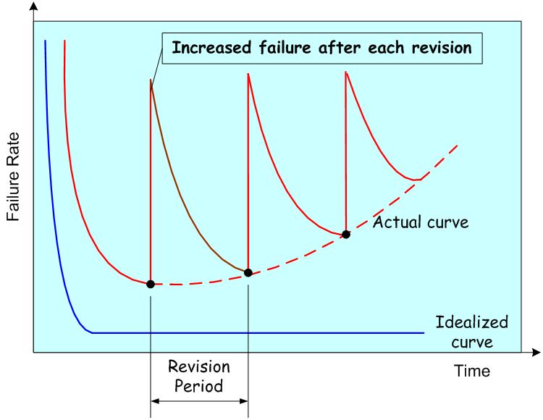
Validity of the Models
Software systems are changed (updated) many times during their life cycle
Reliability growth models assume each change will improve reliability
So the models work for one revision period rather than the whole life cycle

Slide 15
Model Parameters
Execution time: t
Time since the software is running
Execution time, may be different from calendar time
Failure intensity: λ(t)
Number of failures per natural or time unit
Mean cumulative failures: μ(t)
Mean failures experienced in time duration up to time point t
i.e. from start time t₀, expected number of failures in [t₀, t]

Slide 16
Basic Exponential model – Assumptions
Detections of failures are independent of one another
Software failures are observed, i.e. the total number of failures has an upper bound
Perfect debugging is assumed
The execution times (measured in CPU time) between failures are exponentially distributed
The hazard/failure rate is proportional to the number of faults remaining in the program

Slide 17
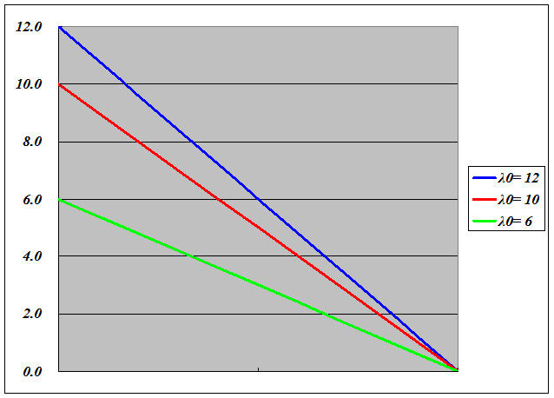
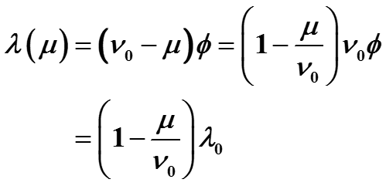
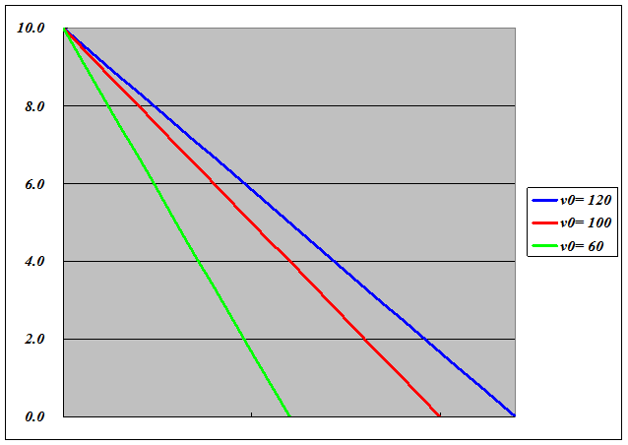
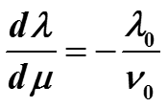
Basic Exponential model (1)
λ
Failure intensity (λ) versus failures experienced (μ)
All failures occurred are removed perfectly and immediately
Slop of failure intensity: dλ/dμ
ν₀=100
μ
λ
λ₀=10
μ
Notes:
v₀，开发质量
λ₀，测试质量

Slide 18
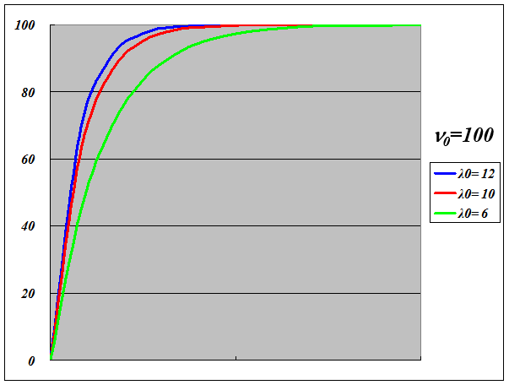
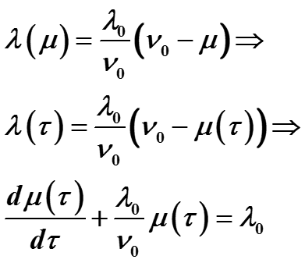
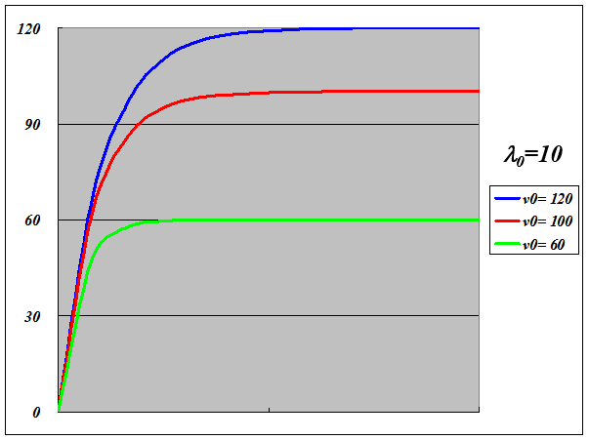

Basic Exponential model (2)
μ
Failures experienced (μ) versus execution time (τ)
τ
μ
τ
Notes:
初始值：μ(0) = 0

Slide 19
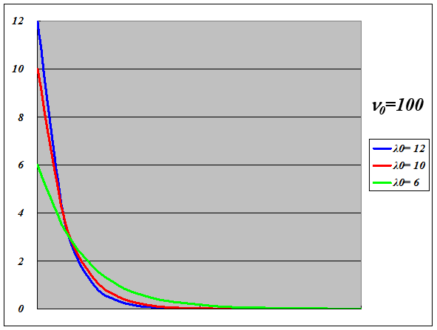
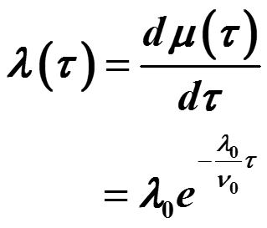
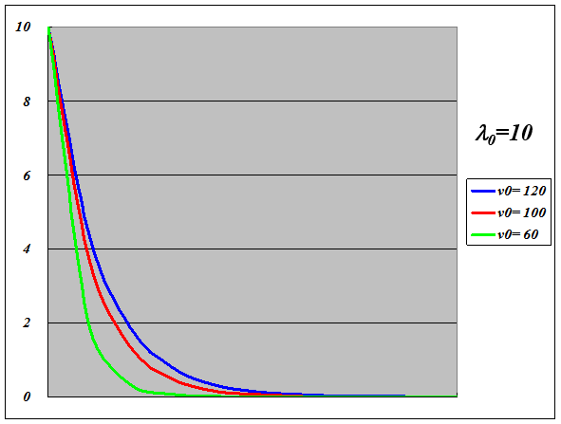
Basic Exponential model (3)
λ
Failure intensity (λ) versus execution time (τ)
τ
λ
τ

Slide 20
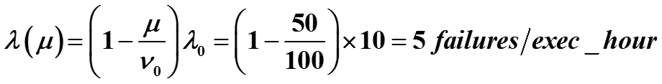
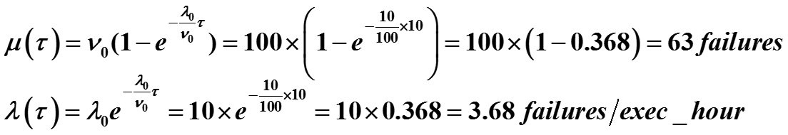
Example – Basic Exponential model
Assume that
A program has 100 failures in infinite time (ν₀), initial failure intensity is 10 failures per execution hour (λ₀)
After 50 failures experienced and removed
After 10 execution hours

Slide 21
Why Logarithmic Poisson Model (1)
Software has highly non-uniform operational profiles
Some functions are executed much more frequently than others
Average level of experience and motivation of failure resolution personnel may drop
Experienced personnel may move to other projects
Test personnel may feel less of the sense of “code ownership”
It becomes more and more difficult to find faults that are causing the failures associated with less frequent runs
For a given failure, associated fault may be only partly removed
Leaving smaller fraction harder to detect
The process of fault removal may introduce new faults

Slide 22
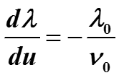

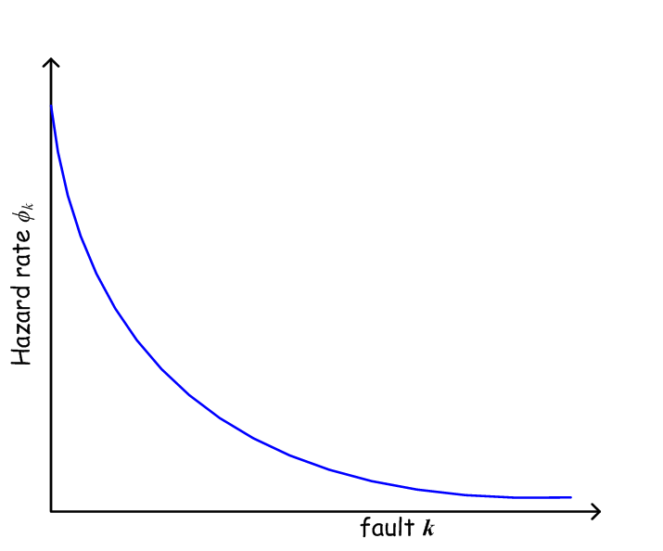
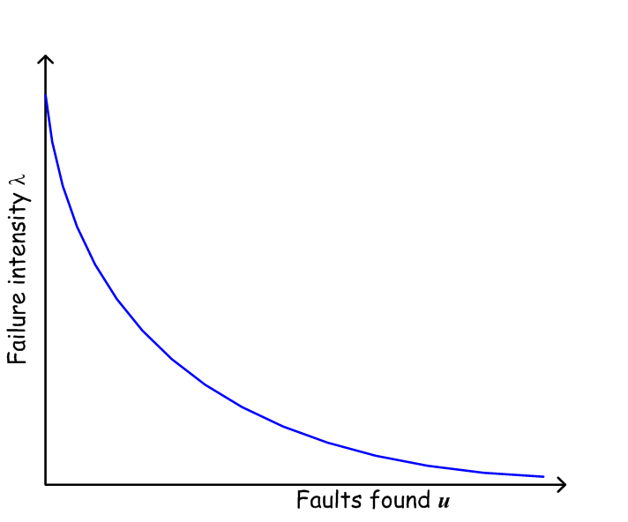

Why Logarithmic Poisson Model (2)
Hazard rate φ_{k} of fault k
May follow a power-law distribution
Failure intensity λ vs. Faults found u
Instead of
Notes:
80-20原则

Slide 23
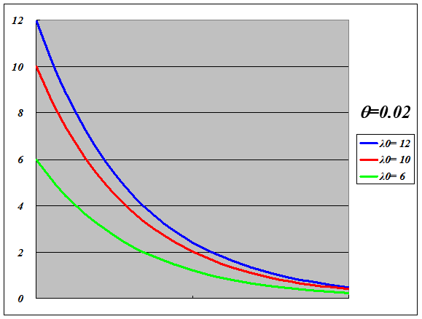

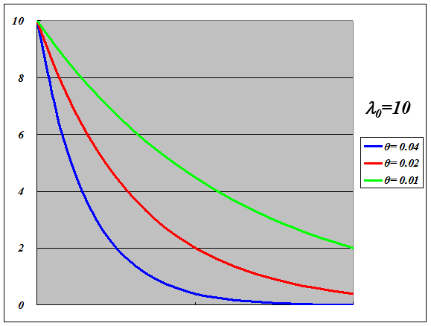
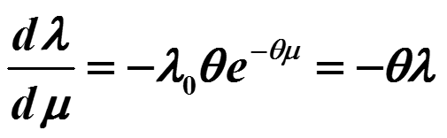
Logarithmic Poisson Model (1)
λ
Failure intensity (λ) versus failures experienced (μ)
Introduce failure intensity decay parameter θ, no ν₀
Slop of failure intensity: dλ/dμ
μ
λ
μ
Notes:
λ₀，测试（+开发）质量
θ，测试质量

Slide 24
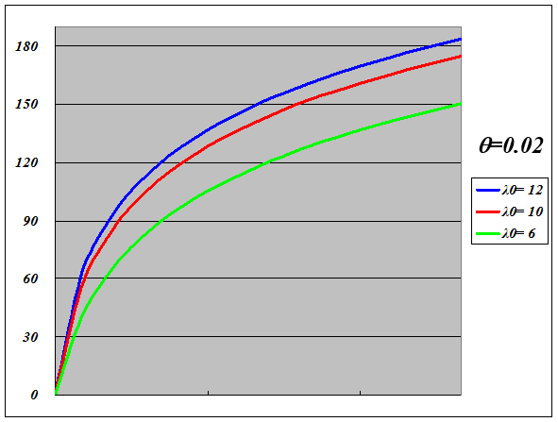
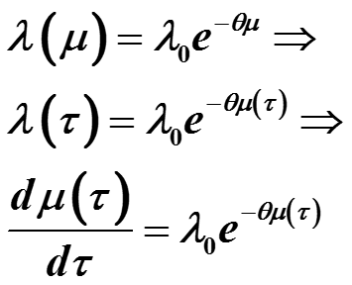
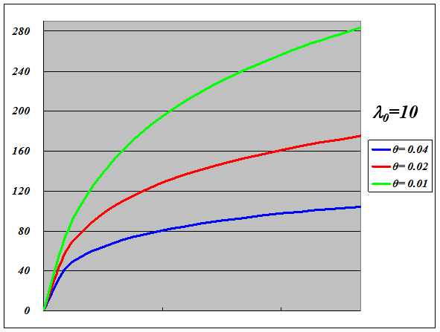
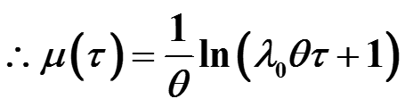
Logarithmic Poisson Model (2)
μ
Failures experienced (μ) versus execution time (τ)
τ
μ
τ
Notes:
初始值：μ(0) = 0

Slide 25
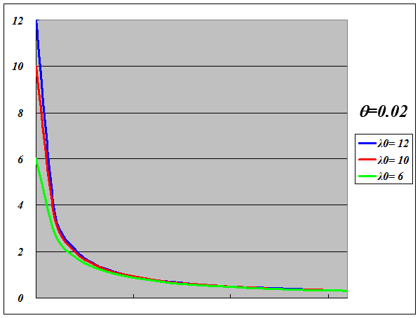
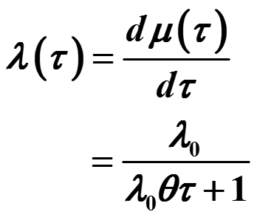
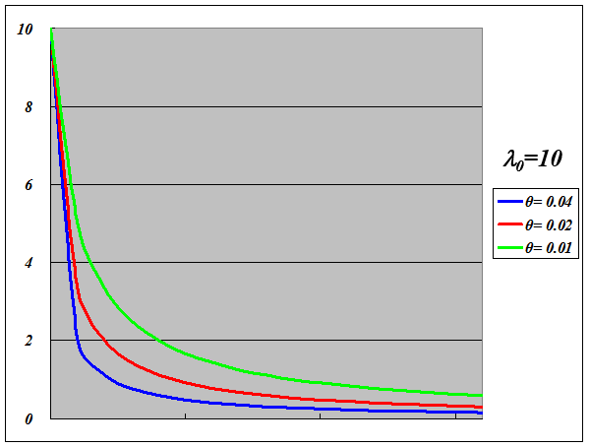
Logarithmic Poisson Model (3)
λ
Failure intensity (λ) versus execution time (τ)
τ
λ
τ

Slide 26
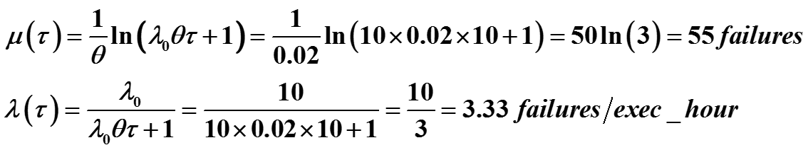
Example – Logarithmic Poisson Model
Assume that
The program’s initial failure intensity is 10 failures per execution hour (λ₀), failure intensity decay parameter (θ) is 0.02 per failure
After 50 failures experienced and removed
After 10 execution hours

Slide 27

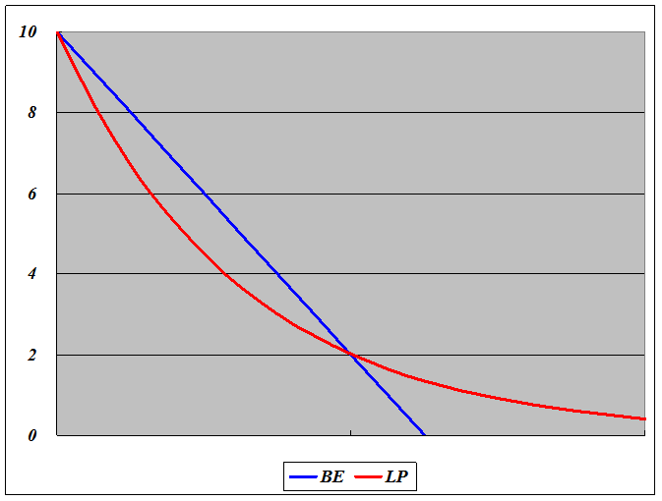



Comparison (1)
Basic Exponential model (BE)
Initial failure intensity
Total failures
Logarithmic Poisson model (LP)
Initial failure intensity
Failure intensity decay parameter
Failure intensity (λ) versus failures experienced (μ)

Slide 28
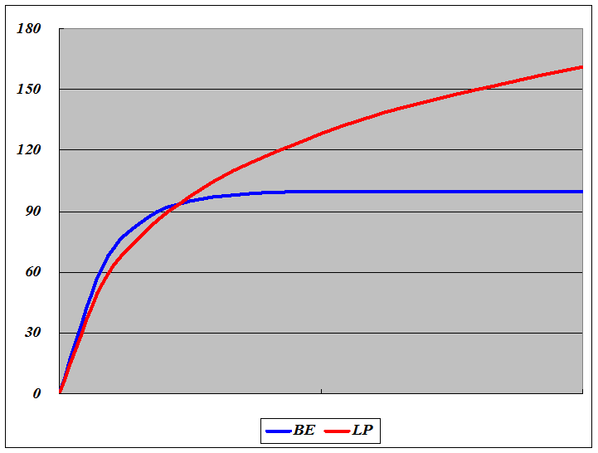
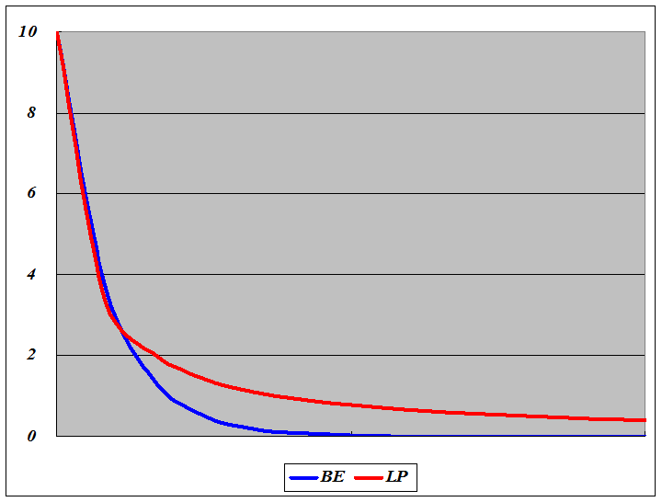
Comparison (2)
Failures experienced (μ) versus execution time (τ)
Failure intensity (λ) versus execution time (τ)

Slide 29
Comparison (3)
 | Parameter | τ = 0 (hour) | μ = 50 (failures) | τ = 10 (hours) | τ = 100 (hours)
BE λ₀ = 10 ν₀ = 100 | failure intensity λ | 10 | 5 | 3.68 | 0.000454
 | failures occurred μ | 0 | 50 | 63 | 100
LP λ₀ = 10 θ = 0.02 | failure intensity λ | 10 | 3.68 | 3.33 | 0.476
 | failures occurred μ | 0 | 50 | 55 | 152

Slide 30

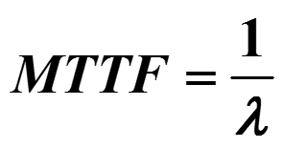

Reliability after Release (1)
Recall the Basic Reliability Model
Failure intensity λ(t) is fixed, i.e. λ
Reliability:
Mean Time to Failure:
Hazard Rate:
Notes:
Single Failure Model

Slide 31



Reliability after Release (2)
Example
The software has failure intensity λ=0.001 failures per exec_hour, then:
Mean Time to Failure is
The probability of reliable execution for 1 hour is
The probability of reliable execution for 80 hours is

Slide 32
Typical Mean Time to Failure
MTTF for Windows 2000 Professional is 2893 hours or 72 40-hour workweeks
MTTF for Windows NT Workstation is 919 hours or 23 workweeks
MTTF for Windows 98 is 216 hours or 5 workweeks

Slide 33
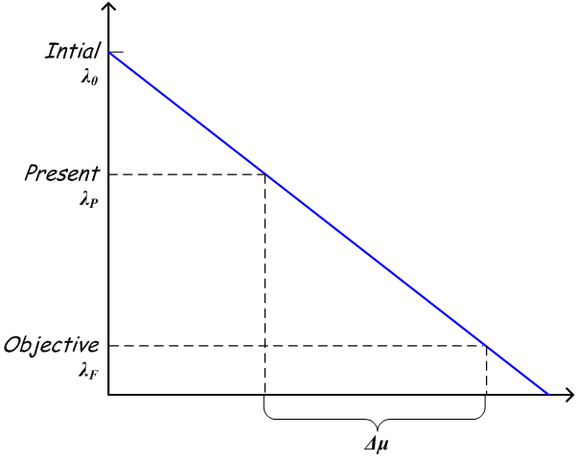
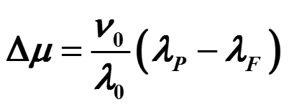
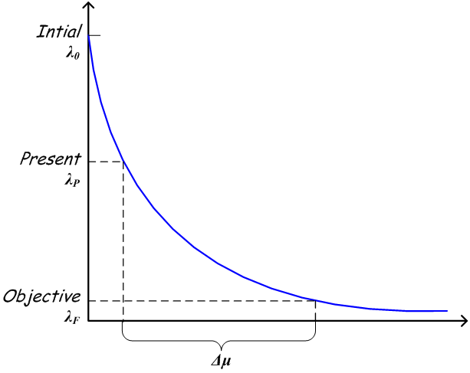
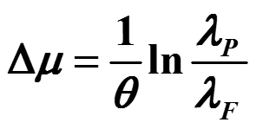
Apply the Models (1)
Set the failure intensity objective λ_{F}
Given current failure intensity λ_{P}
What is the additional expected number of failures Δμ ?
Basic Exponential model
Logarithmic Poisson model

Slide 34

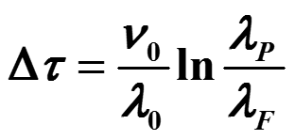
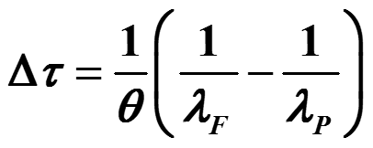
Apply the Models (2)
Set the failure intensity objective λ_{F}
Given current failure intensity λ_{P}
What is the additional expected execution time Δτ ?
Basic Exponential model
Logarithmic Poisson model

Slide 35
Apply the Models – Example (1)
The software:
Initial failure intensity (λ₀) is 10 failures per exec_hour
BE: Total failure in infinite time (ν₀) is 100 failures
LP: Failure intensity decay parameter (θ) is 0.02 per failure
Objective:
Current failure intensity (λ_{P}) is 5 failures per exec_hour
Objective (λ_{F}) is 0.001 failures per exec_hour

Slide 36
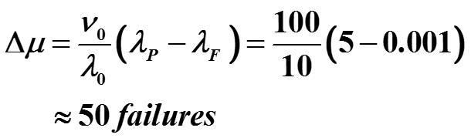
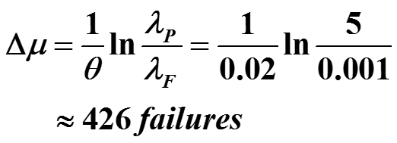
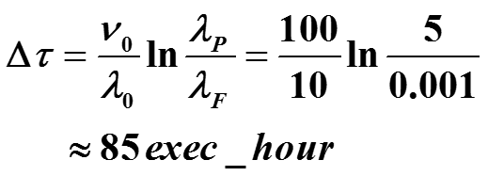
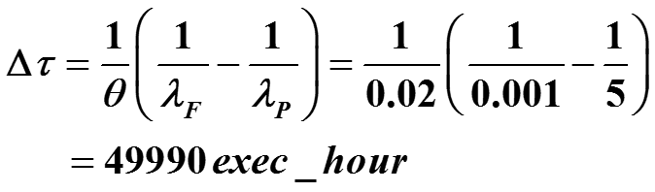
Apply the Models – Example (2)
Basic Exponential model
Additional failures
Additional execution time
Logarithmic Poisson model
Additional failures
Additional execution time

Slide 37
Summary
Randomness and Probability
Probability concepts, Probability distributions, Poisson process
Basic Reliability Models
Reliability model classifications, Static exponential failure model (Homogeneous Poisson process)
Advanced Reliability Models
Basic Exponential model, Logarithmic Poisson model

